Slide 1
Graph Neural Network
Part 2
1

Slide 2
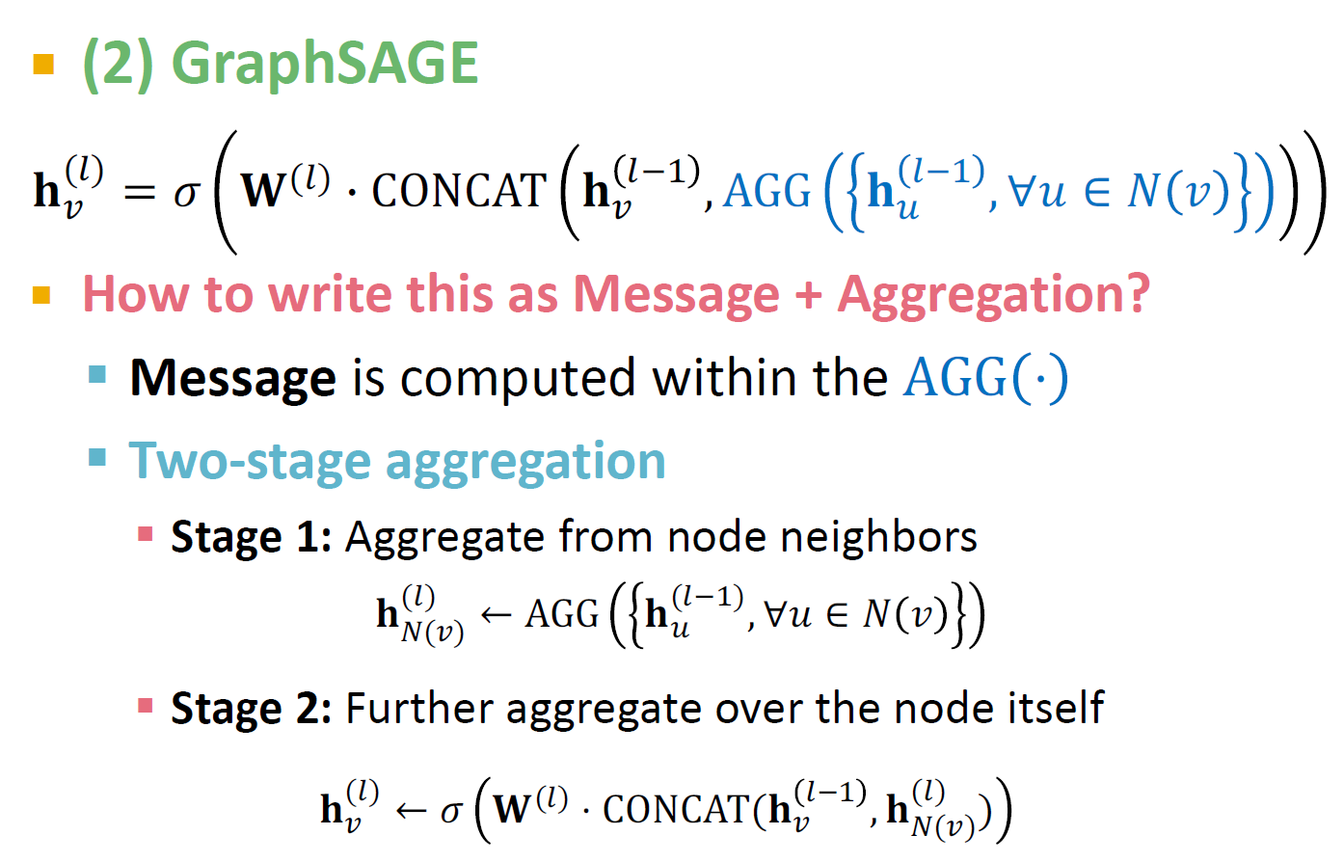
Classical GNN Layers: GraphSAGE
Hamilton et al. Inductive Representation Learning on Large Graphs, NeurIPS 2017
2

Slide 3
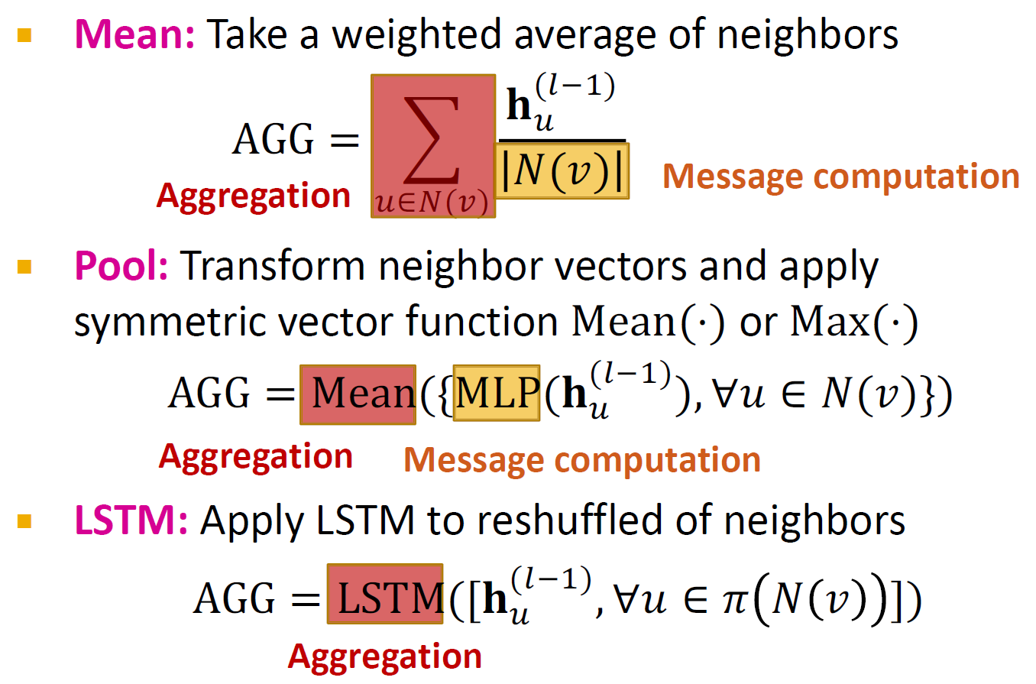
GraphSAGE Neighbor Agg.
3

Slide 4







Hamilton et al. Inductive Representation Learning on Large Graphs, NeurIPS 2017
Node Neighorhood Sampling
Previously:
All the nodes are used for message passing
A
TARGET NODE
B B
C
A
B
A
C
A
C
F
E
D
F
E
D
INPUT GRAPH
A
New idea: (Randomly) sample a node’s neighborhood for message passing
4

Slide 5
Neighorhood Sampling Example
For example, we can randomly choose 2 neighbors to pass messages in a given layer
Only nodes 𝐵 and 𝐷 will pass messages to 𝐴
A
TARGET NODE
B
B
C
A
B
A
C
A
C
F
E
D
E
D
INPUT GRAPH
A
5

Slide 6
Neighorhood Sampling Example
In the next layer when we compute the embeddings, we can sample different neighbors
Only nodes 𝐶 and 𝐷 will pass messages to 𝐴
TARGET NODE
B
A
C
F
D
E
INPUT GRAPH
6

Slide 7
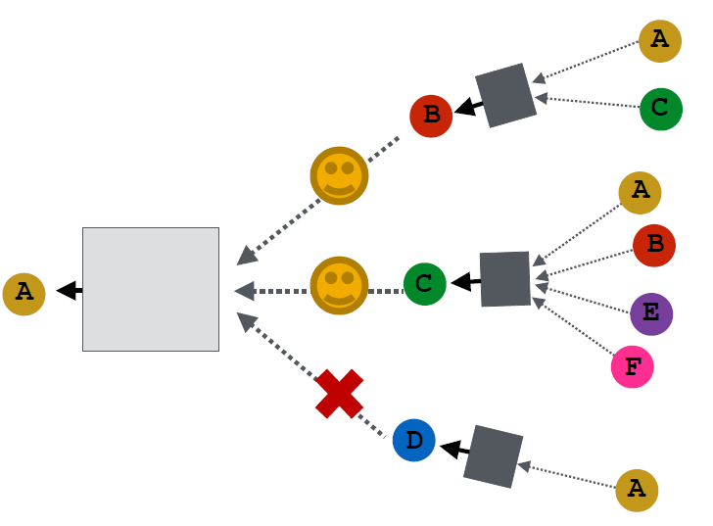
Ying et al. Graph Convolutional Neural Networks for Web-Scale Recommender Systems, KDD 2018
Neighorhood Sampling Example
In expectation, we get embeddings similar to the case where all the neighbors are used
Benefits: Greatly reduces computational cost
And in practice it works great!
TARGET NODE
A
C
F
D
E
INPUT GRAPH
Acknowledgement: Jure Leskovec, Stanford University
7

Slide 8
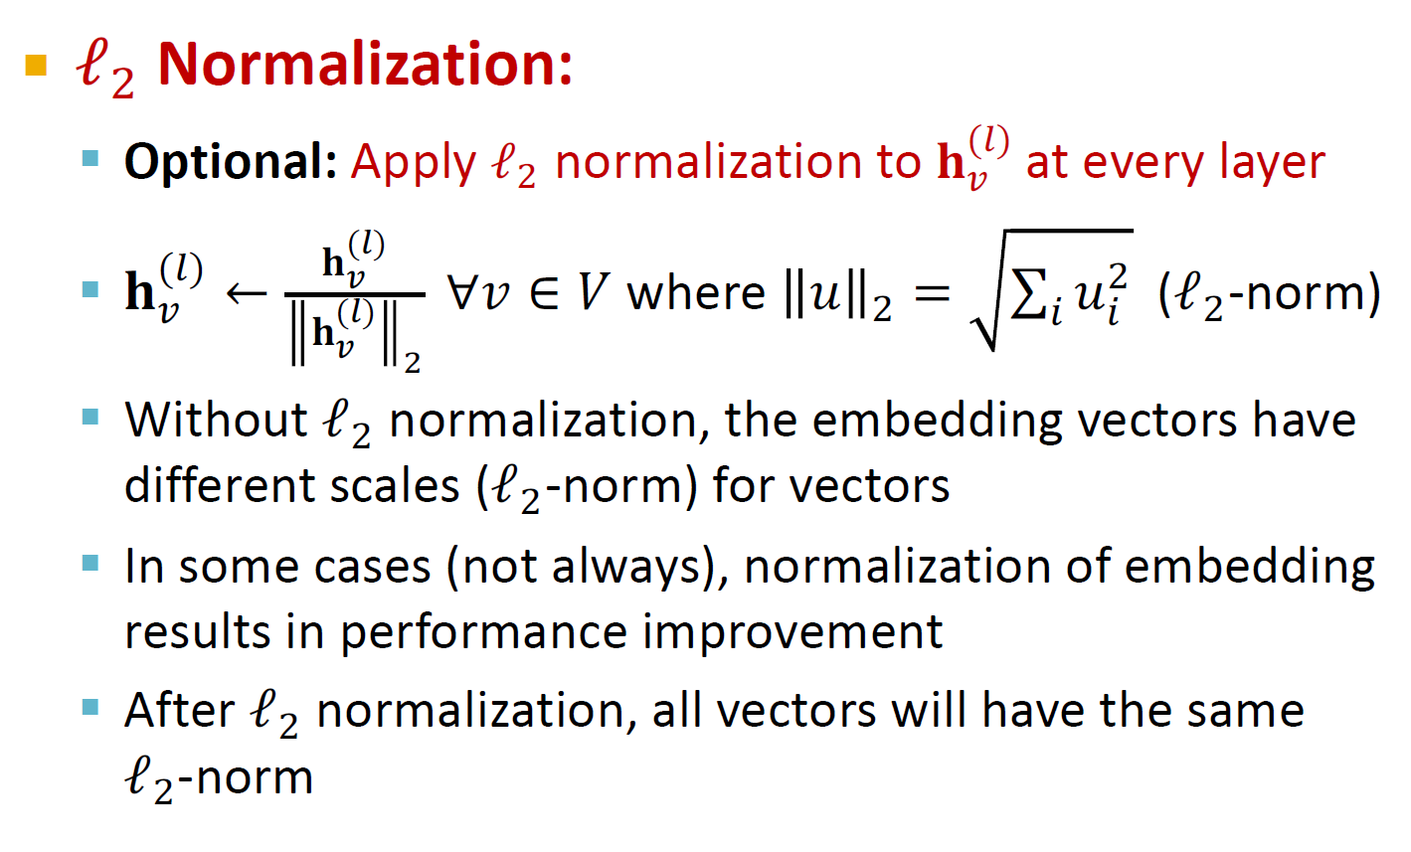
GraphSAGE: L₂ Normalization
8

Slide 9
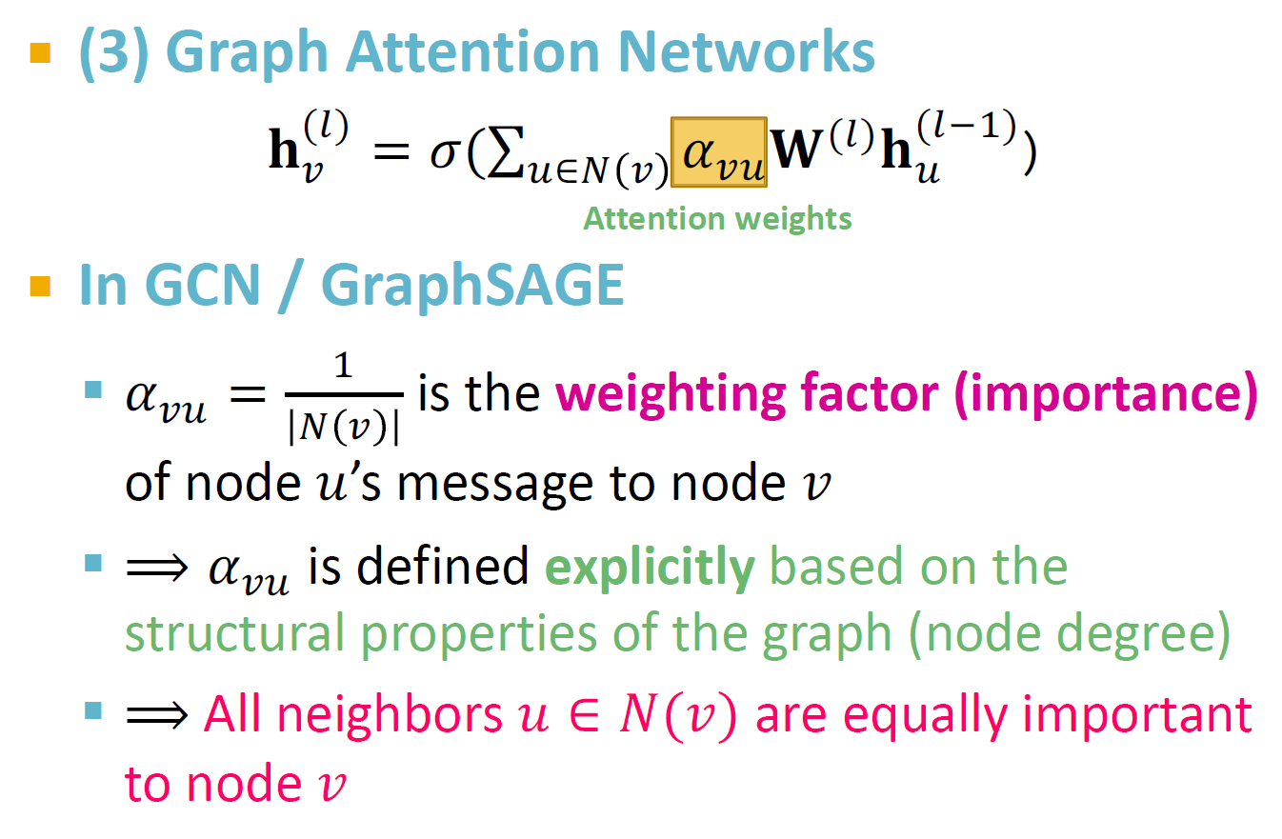
Classical GNN Layers: GAT(1)
9

Slide 10
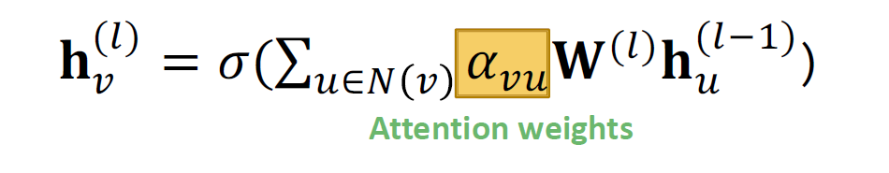
Classical GNN Layers: GAT(2)
(3) Graph Attention Networks
Not all node’s neighbors are equally important
Attention is inspired by cognitive attention.
The attention 𝜶_{𝒗𝒖} focuses on the important parts of the input data and fades out the rest.
Idea: the NN should devote more computing power on that small but important part of the data.
Which part of the data is more important depends on the context and is learned through training.
10

Slide 11
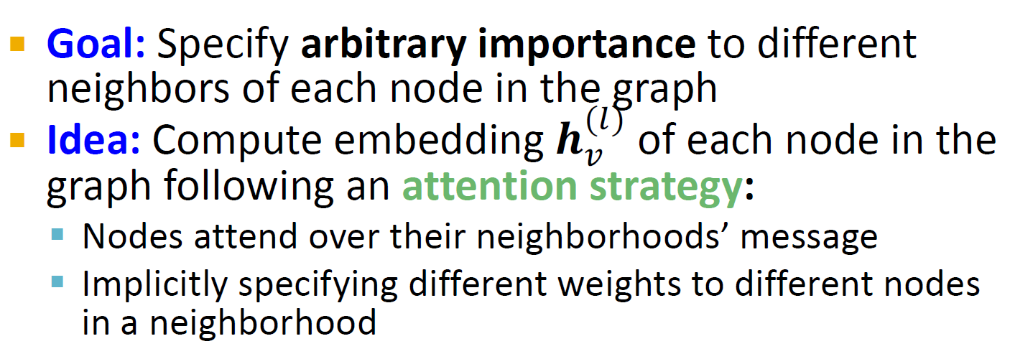
Can we do better than simple neighborhood aggregation?
[Velickovic et al., ICLR 2018; Vaswani et al., NIPS 2017]
Graph Attention Networks
Can we let weighting factors 𝜶_{𝒗𝒖} to be learned?
11

Slide 12
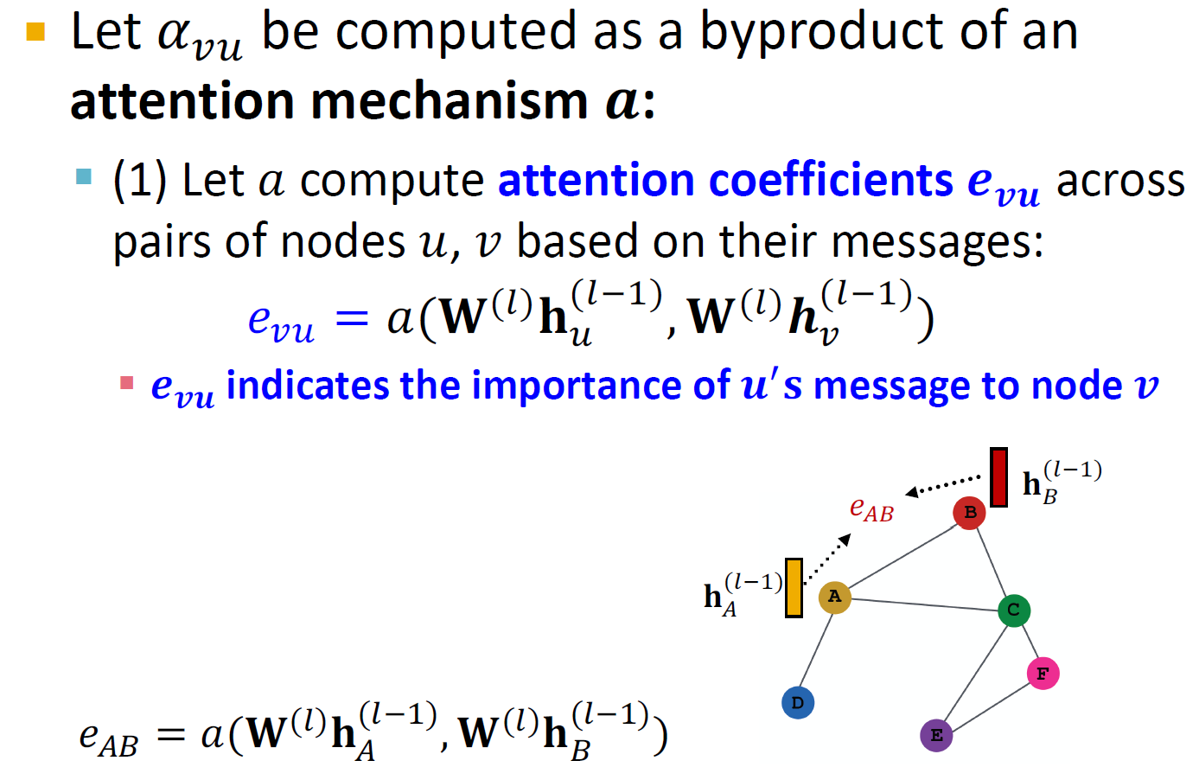
Attention Mechanism (1)
12

Slide 13
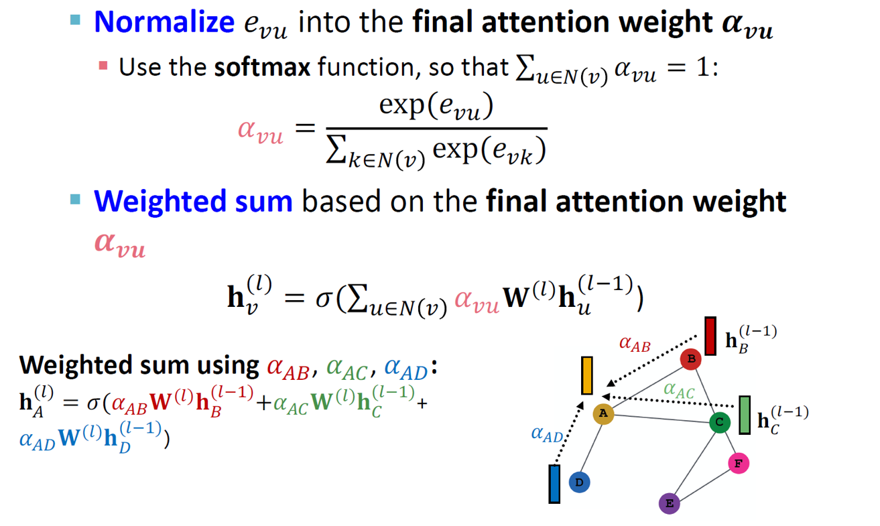
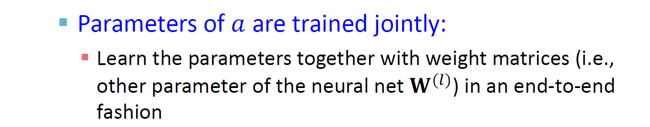
Attention Mechanism (2)
13

Slide 14
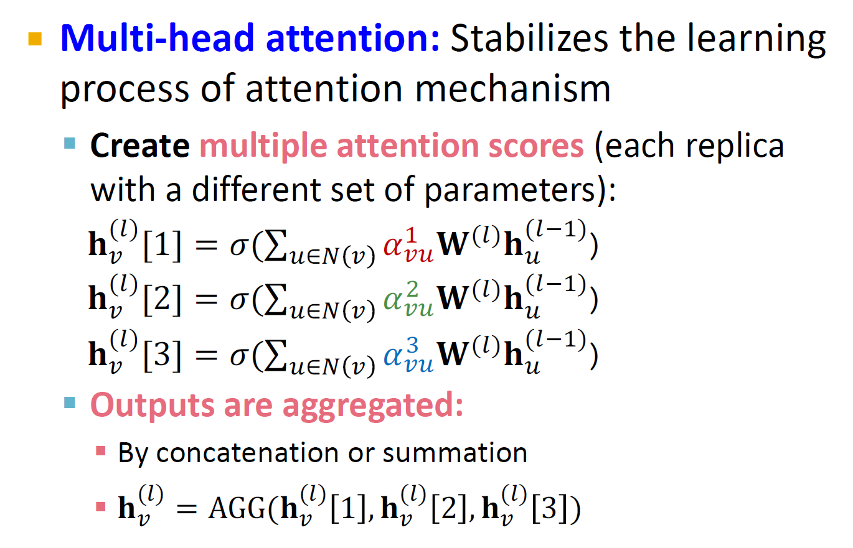
Attention Mechanism (4)
14

Slide 15
Benefits of Attention Mechanism
Key benefit: Allows for (implicitly) specifying different importance values (𝜶_{𝒗𝒖}) to different neighbors
Computationally efficient:
Computation of attentional coefficients can be parallelized across all edges of the graph
Aggregation may be parallelized across all nodes
Storage efficient:
Sparse matrix operations do not require more than
𝑂(𝑉 + 𝐸) entries to be stored
Fixed number of parameters, irrespective of graph size
Localized:
Only attends over local network neighborhoods
Inductive capability:
It is a shared edge-wise mechanism
It does not depend on the global graph structure
15

Slide 16
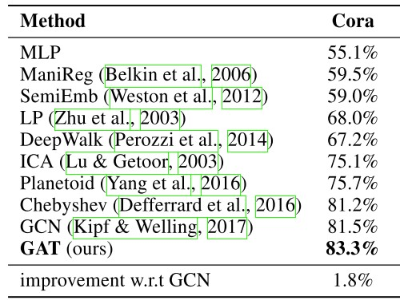
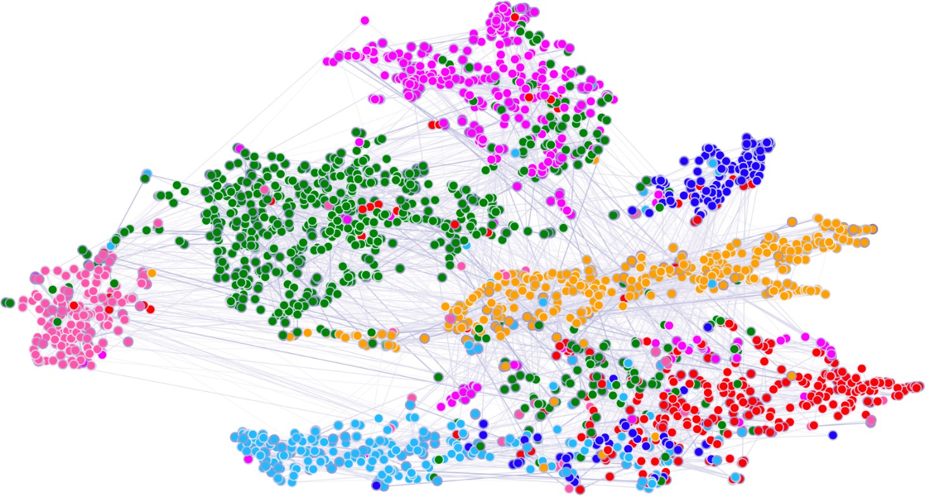

GAT: Cora Citation Net
Attention mechanism can be used with many different graph neural network models
In many cases, attention leads to performance gains
t-SNE plot of GAT-based node embeddings:
Node color: 7 publication classes
Edge thickness: Normalized attention coefficients between
nodes 𝑖 and 𝑗, across eight attention heads,
16

Slide 17
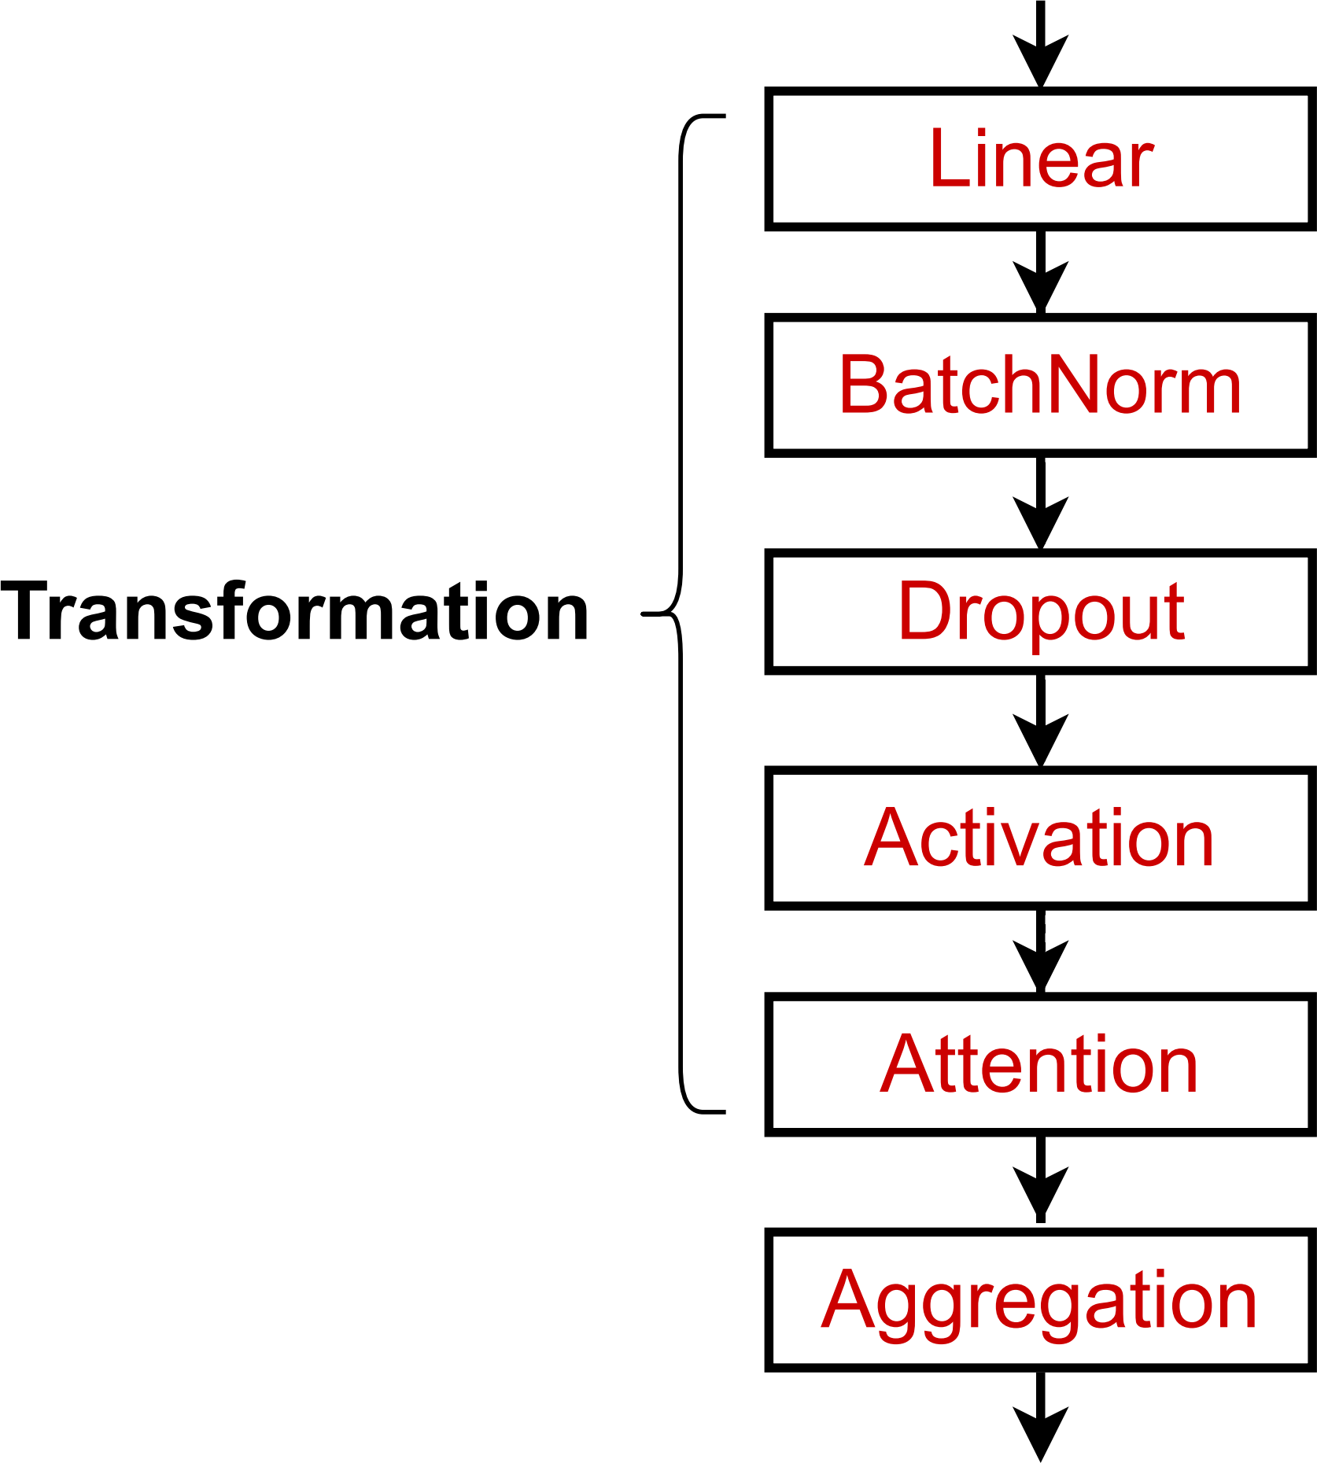
GNN Layer in Practice
J. You, R. Ying, J. Leskovec. Design Space of Graph Neural Networks, NeurIPS 2020
In practice, these classic GNN layers are a great starting point
We can often get better performance by considering a general GNN layer design
Concretely, we can include modern deep learning modules that proved to be useful in many domains
A suggested GNN Layer
17

Slide 18
GNN Layer in Practice
J. You, R. Ying, J. Leskovec. Design Space of Graph Neural Networks, NeurIPS 2020
Many modern deep learning modules can be incorporated into a GNN layer
Batch Normalization:
Stabilize neural network training
Dropout:
Prevent overfitting
Attention/Gating:
Control the importance of a message
More:
Any other useful deep learning modules
A suggested GNN Layer
18

Slide 19
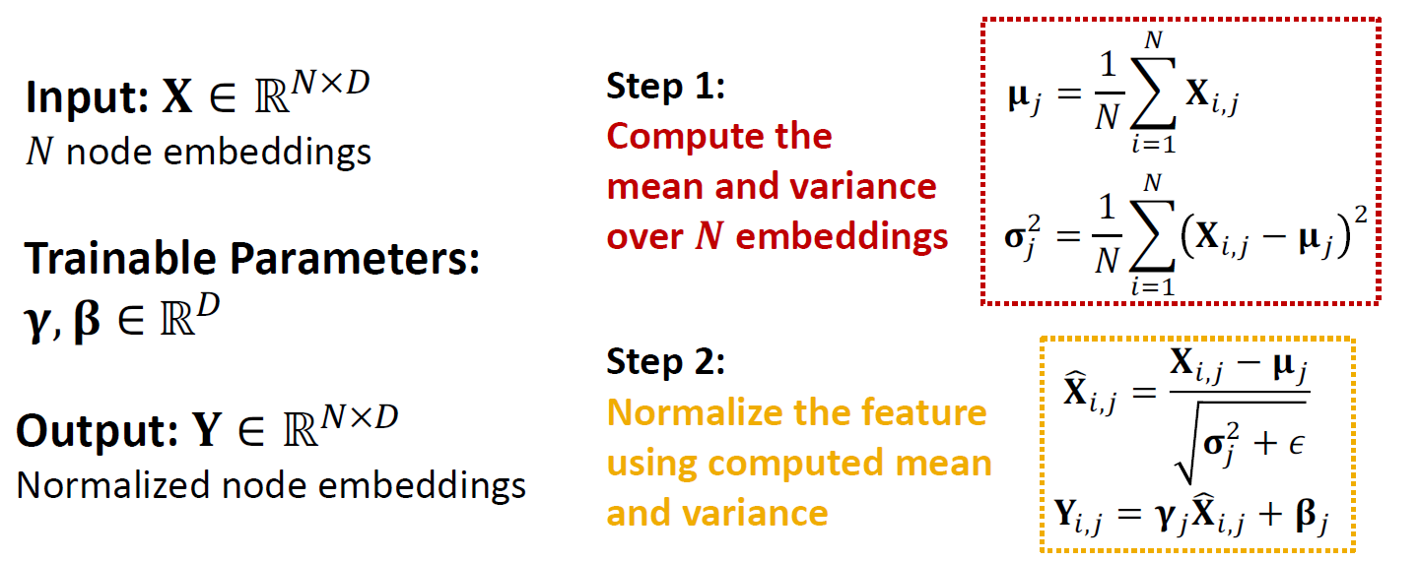
Batch Normalization
S. Loffe, C.Szegedy. Batch Normalization: Accelerating Deep Network Training by Reducing Internal Covariate Shift, ICML 2015
Goal: Stabilize neural networks training
Idea: Given a batch of inputs (node embeddings)
Re-center the node embeddings into zero mean
Re-scale the variance into unit variance
19

Slide 20
Dropout
Srivastava et al. Dropout: A Simple Way to Prevent Neural Networks from Overfitting, JMLR 2014
Goal: Regularize a neural net to prevent overfitting.
Idea:
During training: with some probability 𝑝, randomly set neurons to zero (turn off)
During testing: Use all the neurons for computation
Dropout
Removed neurons
20

Slide 21
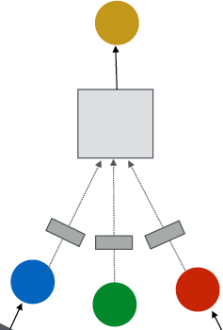

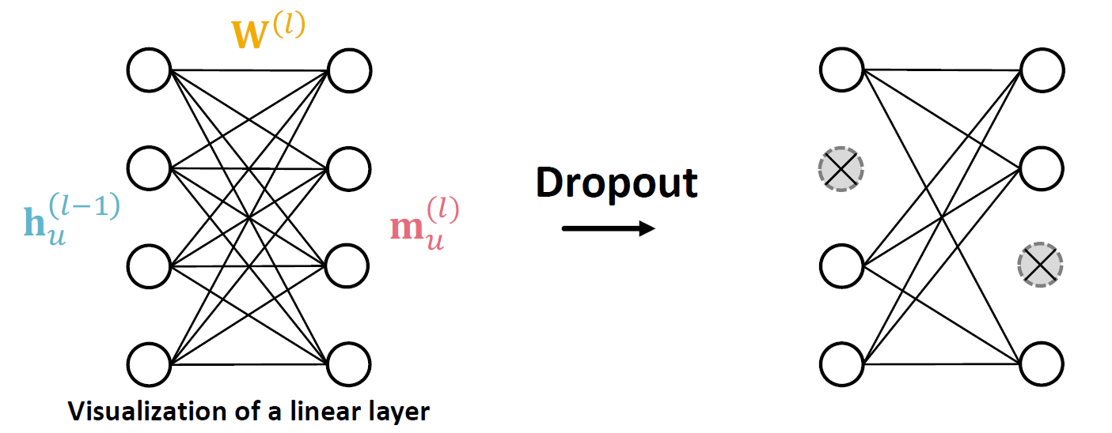
Dropout for GNNs
In GNN, Dropout is applied to the linear layer in the message function
(2) Aggregation
A simple message function with linear
(1) Message
layer:
21

Slide 22
GNN Layer in Practice
Summary: Modern deep learning modules can be included into a GNN layer for better performance
A GNN Layer
Designing novel GNN layers is still an active research frontier!
Suggested resources: You can explore diverse GNN designs or try out your own ideas in GraphGym
22

Slide 23
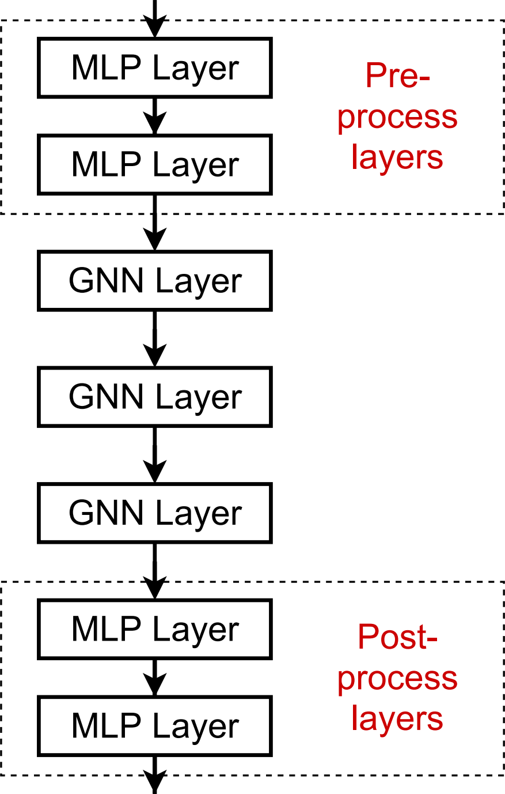
Expressive Power for Shallow GNNS
How to make a shallow GNN more expressive?
Solution 2: Add layers that do not pass messages
A GNN does not necessarily only contain GNN layers
E.g., we can add MLP layers (applied to each node) before and after GNN layers, as pre-process layers and post-process layers
Pre-processing layers: Important when encoding node features is necessary.
E.g., when nodes represent images/text
Post-processing layers: Important when reasoning / transformation over node embeddings are needed
E.g., graph classification, knowledge graphs
In practice, adding these layers works great!
23

Slide 24
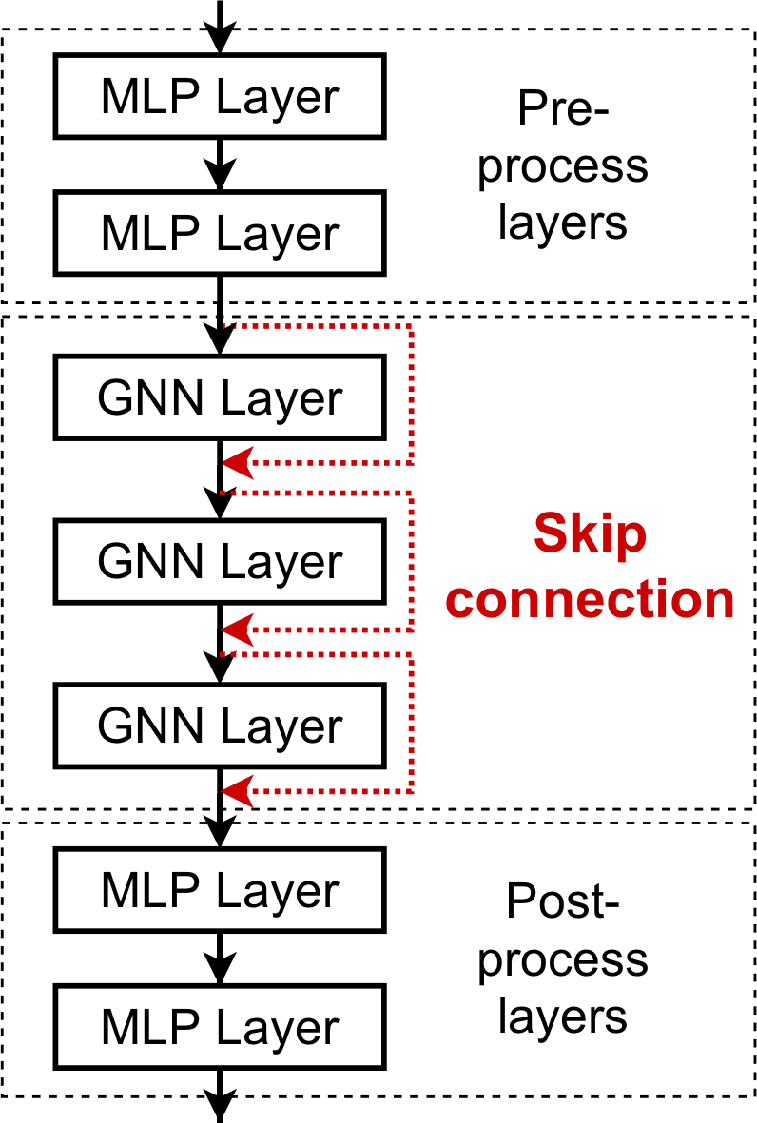
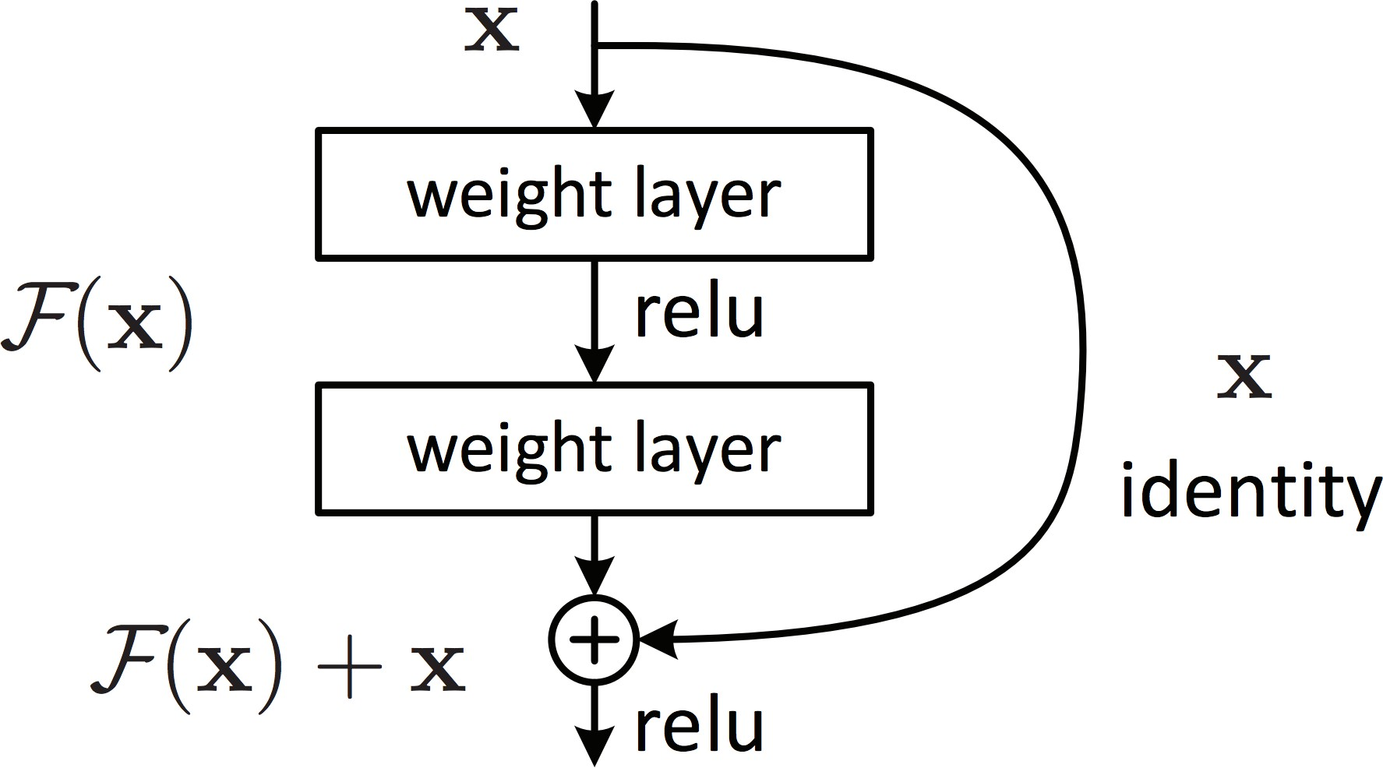
Design GNN Layer Connectivity
He et al. Deep Residual Learning for Image Recognition, CVPR 2015
What if my problem still requires many GNN layers?
Lesson 2: Add skip connections in GNNs
Observation from over-smoothing: Node embeddings in earlier GNN layers can sometimes better differentiate nodes
Solution: We can increase the impact of earlier layers on the final node embeddings, by adding shortcuts in GNN
Duplicate into two
branches
Idea of skip connections:
Before adding shortcuts:
𝑭 𝐱
After adding shortcuts:
𝑭 𝐱 + 𝐱
Sum two
branches
24

Slide 25
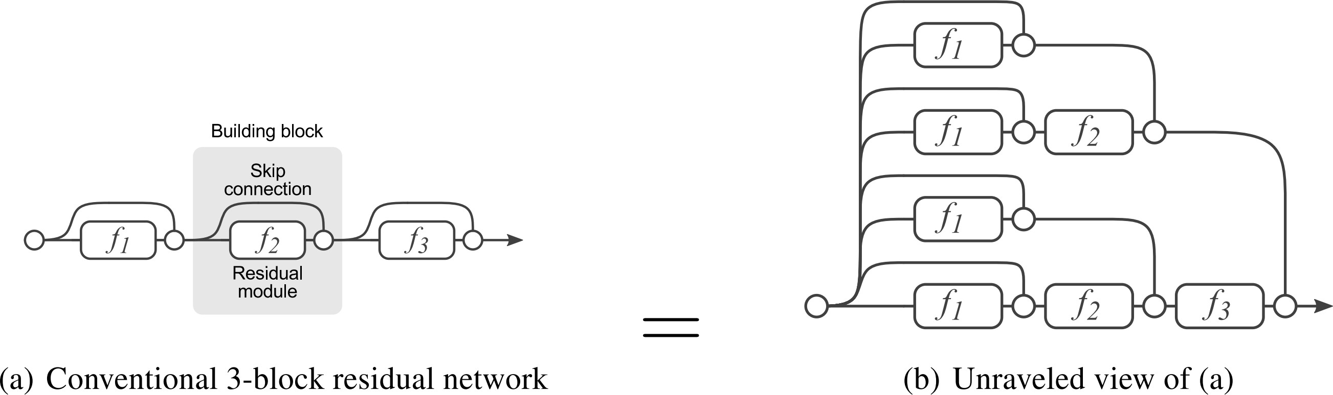
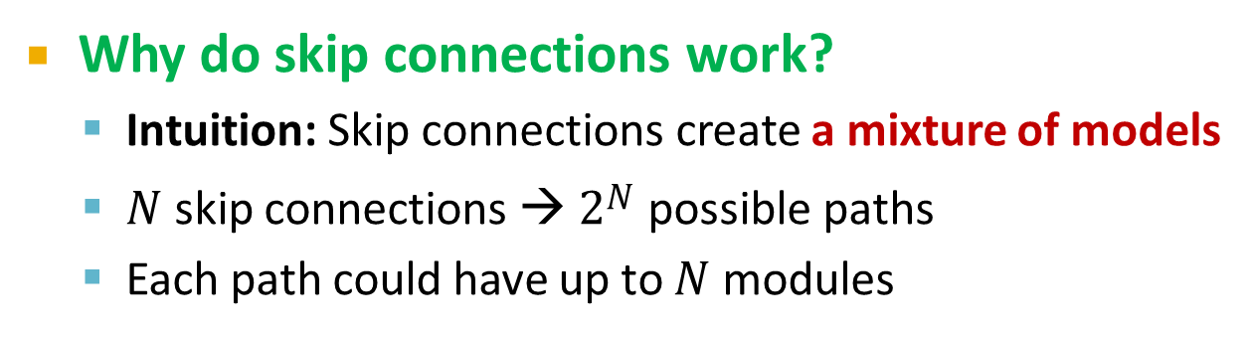
Skip Connections
Why do skip connections work?
Intuition: Skip connections create a mixture of models
𝑁 skip connections → 2$N$ possible paths
Each path could have up to 𝑁 modules
We automatically get a mixture of shallow GNNs and deep GNNs
All the possible paths:
2 ∗ 2 ∗ 2 = 2³ = 8
Path 2: skip this module
Path 1: include this module
Veit et al. Residual Networks Behave Like Ensembles of Relatively Shallow Networks, ArXiv 2016
25

Slide 26
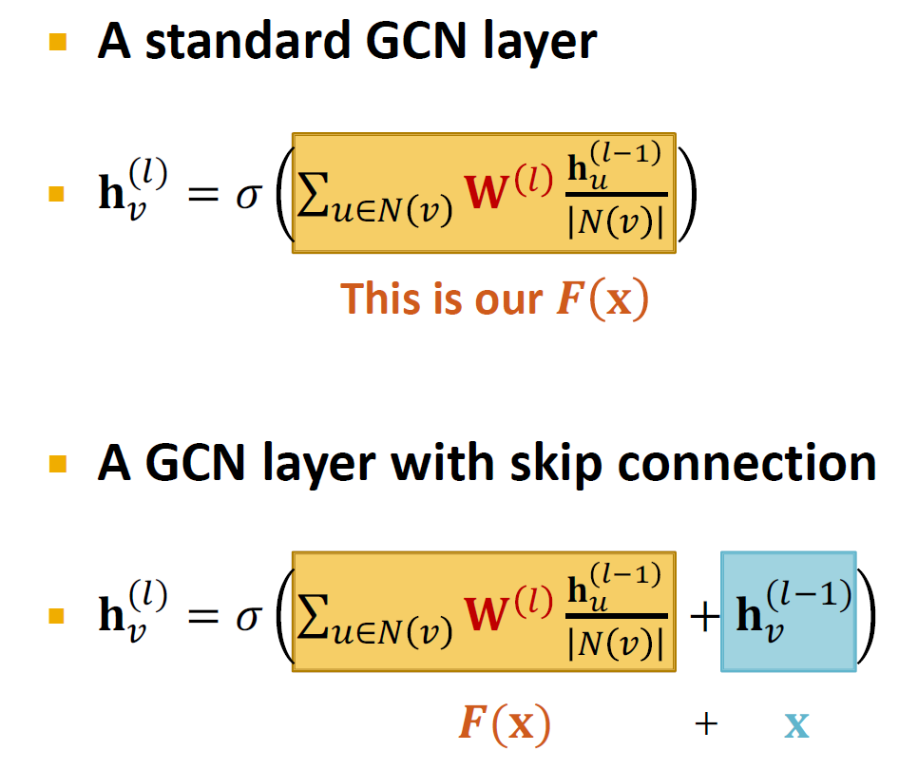
GCN with Skip Connections
26

Slide 27
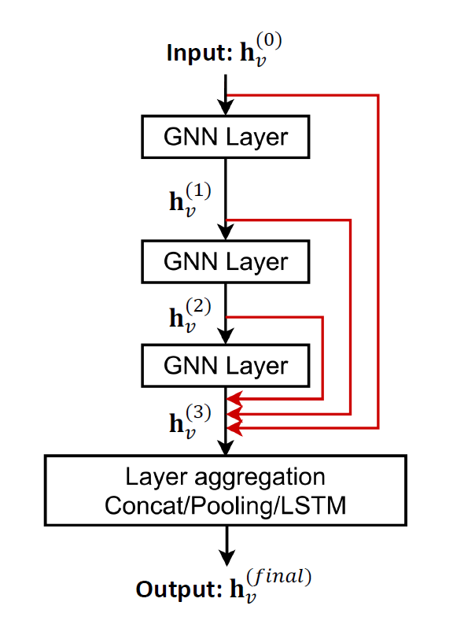
Other Skip Connections
Xu et al. Representation learning on graphs with jumping knowledge networks, ICML 2018
Other options: Directly skip to the last layer
The final layer directly aggregates from the all the node embeddings in the previous layers
27

Slide 28
Graph Augmentation
28

Slide 29
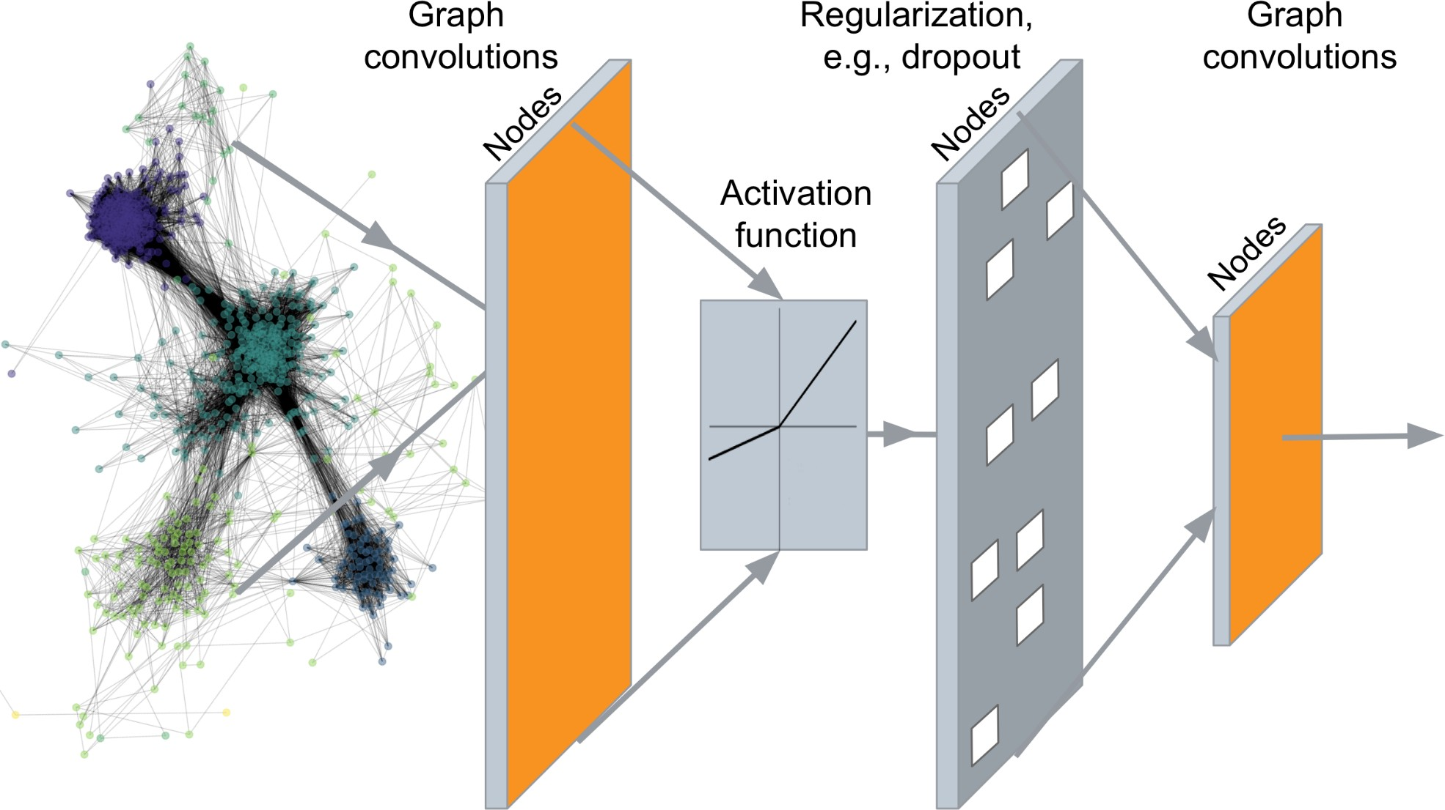
Recap: Deep Graph Encoders
…
Output: Node embeddings. Also, we can embed subgraphs and entire graphs
29

Slide 30




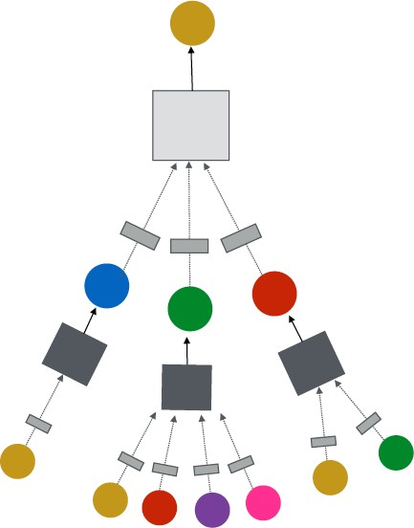


Recap: GNN Framework
J. You, R. Ying, J. Leskovec. Design Space of Graph Neural Networks, NeurIPS 2020
TARGET NODE
B
(5) Learning objective
A
C
D
E
F
INPUT GRAPH
(2) Aggregation
(1) Message
GNN Layer 1
(3) Layer connectivity
GNN Layer 2
(4) Graph augmentation
30

Slide 31
Idea: Raw input graph ≠ computational graph
J. You, R. Ying, J. Leskovec. Design Space of Graph Neural Networks, NeurIPS 2020
GNN Framework
Graph feature augmentation
Graph structure augmentation
TARGET NODE
B
A
C
D
E
INPUT GRAPH
F
(4) Graph augmentation
31

Slide 32
Our assumption so far has been
Why Augment Graphs
Raw input graph = computational graph Reasons for breaking this assumption
Features:
The input graph lacks features
Graph structure:
The graph is too sparse → inefficient message passing
The graph is too dense → message passing is too costly
The graph is too large → cannot fit the computational graph into a GPU
32

Slide 33
Graph Augmentation Approaches
Graph Feature augmentation
The input graph lacks features → feature augmentation
Graph Structure augmentation
The graph is too sparse → Add virtual nodes / edges
The graph is too dense → Sample neighbors when doing message passing
The graph is too large → Sample subgraphs to compute embeddings
33

Slide 34
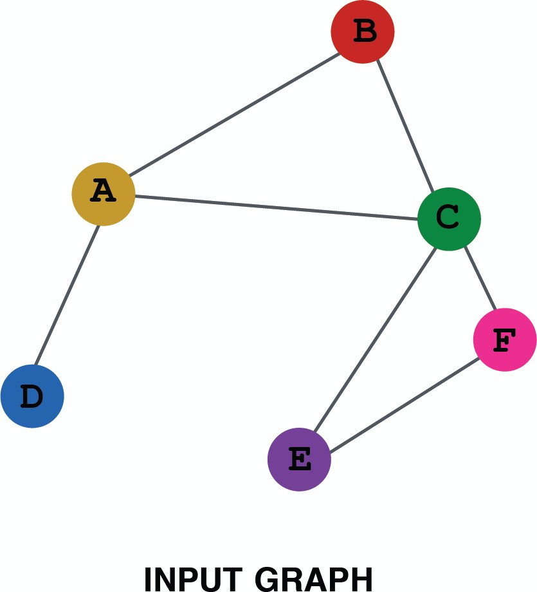
Features Augmentation on Graphs
When might we need feature augmentation?
(1) Input graph does not have node features
This is common when we only have the adj. matrix
Standard approaches:
a) Assign constant values to nodes
1
1
1
1
1
1
34

Slide 35
Features Augmentation on Graphs
When might we need feature augmentation?
(1) Input graph does not have node features
This is common when we only have the adj. matrix
Standard approaches:
b) Assign unique IDs to nodes
These IDs are converted into one-hot vectors
2
One-hot vector for node with ID=5
1
3
ID = 5
6
[0, 0, 0, 0, 1, 0]
Total number of IDs = 6
4
5
35

Slide 36
Features Augmentation on Graphs
Feature augmentation: constant vs. one-hot
 | Constant node feature 1 1 ₁ ₁ 1 1 | One-hot node feature 2 1 ₃ ₄ 6 5
Expressive power | Medium. All the nodes are identical, but GNN can still learn from the graph structure | High. Each node has a unique ID, so node-specific information can be stored
Inductive learning (Generalize to unseen nodes) | High. Simple to generalize to new nodes: we assign constant feature to them, then apply our GNN | Low. Cannot generalize to new nodes: new nodes introduce new IDs, GNN doesn’t know how to embed unseen IDs
Computational cost | Low. Only 1 dimensional feature | High. 𝑂 𝑉 dimensional feature, cannot apply to large graphs
Use cases | Any graph, inductive settings (generalize to new nodes) | Small graph, transductive settings (no new nodes)
36

Slide 37
J. You, J. Gomes-Selman, R. Ying, J. Leskovec. Identity-aware Graph Neural Networks, AAAI 2021
Features Augmentation on Graphs
When might we need feature augmentation?
(2) Certain structures are hard to learn by GNN
Example: Cycle count feature:
Can GNN learn the length of a cycle that 𝑣₁ resides in?
Unfortunately, no
𝑣₁ resides in a cycle with length 3
𝑣₁
𝑣₁ resides in a cycle with length 4
𝑣₁
37

Slide 38
Features Augmentation on Graphs
𝒗_{𝟏} cannot differentiate which graph it resides in
Because all the nodes in the graph have degree of 2
The computational graphs will be the same binary tree
𝑣! resides in a cycle with length 3
𝑣! resides in a cycle with length 4
The computational graphs for node 𝒗_{𝟏} are always the same
𝒗_{𝟏}
𝒗₁
𝒗₂
𝑣! resides in a cycle with infinite length
…
…
𝒗₁
…
38

Slide 39
Features Augmentation on Graphs
When might we need feature augmentation?
(2) Certain structures are hard to learn by GNN
Solution: We can use cycle count as augmented node features
Augmented node feature for 𝒗_{𝟏}
[0, 0, 0, 1, 0, 0]
Augmented node feature for 𝒗_{𝟏}
[0, 0, 0, 0, 1, 0]
We start
from cycle
with length 0
𝑣₁ resides in a cycle with length 3
𝑣₁
𝑣₁ resides in a cycle with length 4
𝑣₁
39

Slide 40
Features Augmentation on Graphs
When might we need feature augmentation?
(2) Certain structures are hard to learn by GNN
Other commonly used augmented features:
Node degree
Clustering coefficient
Centrality
…
40

Slide 41












Add Virtual Nodes/ Edges
Motivation: Augment sparse graphs
(1) Add virtual edges
Common approach: Connect 2-hop neighbors via virtual edges
Intuition: Instead of using adj. matrix 𝐴 for GNN computation, use 𝐴 + 𝐴²
Authors Papers
Use cases: Bipartite graphs
Author-to-papers (they authored)
2-hop virtual edges make an author-author collaboration graph
A
B
C
D
E
41

Slide 42
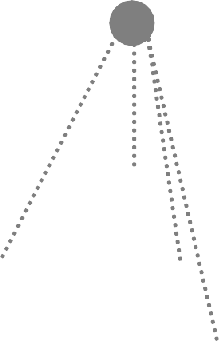
Add Virtual Nodes/ Edges
Motivation: Augment sparse graphs
(2) Add virtual nodes
The virtual node will connect to all the nodes in the graph
Suppose in a sparse graph, two nodes have shortest path distance of 10
After adding the virtual node, all the nodes will have a distance of two
Node A – Virtual node – Node B
Benefits: Greatly improves message passing in sparse graphs
The virtual node
42

